Slide 1

Can (role-specific) sentiment in earnings call transcripts help predict stock price movements?
A Sentiment Analysis of the S&P 100
University of Amsterdam Applied AI Research Seminar Group 10:
Jorge Matamala Yepes (13955764)
Antonina Anastasova (25854736)
Yifan Duan (13206850)
Jasmine Yang (15468666)
JANUARY. 15. 2024
Notes:
Hi everyone, we are group 10. Today, we will be presenting our research project for the course. My name is Jorge, and I am with Nina, Yifan and Jasmine.
During this presentation we will guide you through the dataset we used, the data
Our first goal was to perform a detailed sentiment analysis on the earning calls transcripts

Slide 2
Overview
Data Sources
Key Considerations
Data Exploration
VADER
FinBERT
Conclusion and Q&A

Slide 3
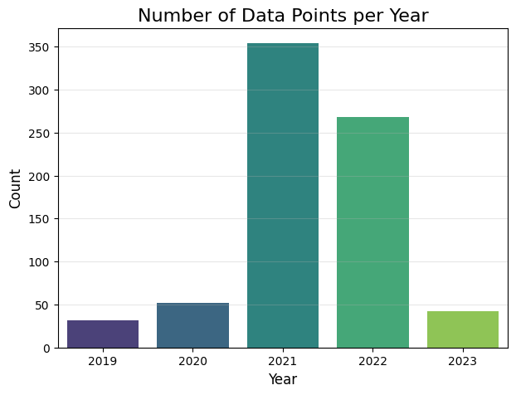
Data Sources
S&P 100
Earnings Calls Transcripts Earnings Call Transcripts | The Motley Fool
19,000 earnings call transcripts from firms, sourced from.
In these calls, companies present their performance, opportunities, and risks to investors, who then have the opportunity to raise concerns and ask questions.
Yahoo Finance Historical stock price

Slide 4
Key Considerations
Is there a correlation between stock prices and sentiment scores from earnings calls?
Do earnings calls influence stock price movements?
What is the sentiment of the call, and what common words or topics emerge?
How does the stock price change before and after the call?
What roles do participants play, and how do their contributions shape sentiment?
How do sentiment patterns differ across participant groups in the call?

Slide 5

Data Exploration
Very, very long transcripts
Can we detect sentiment in these transcripts?
What’s the best approach to analyze this?

Slide 6
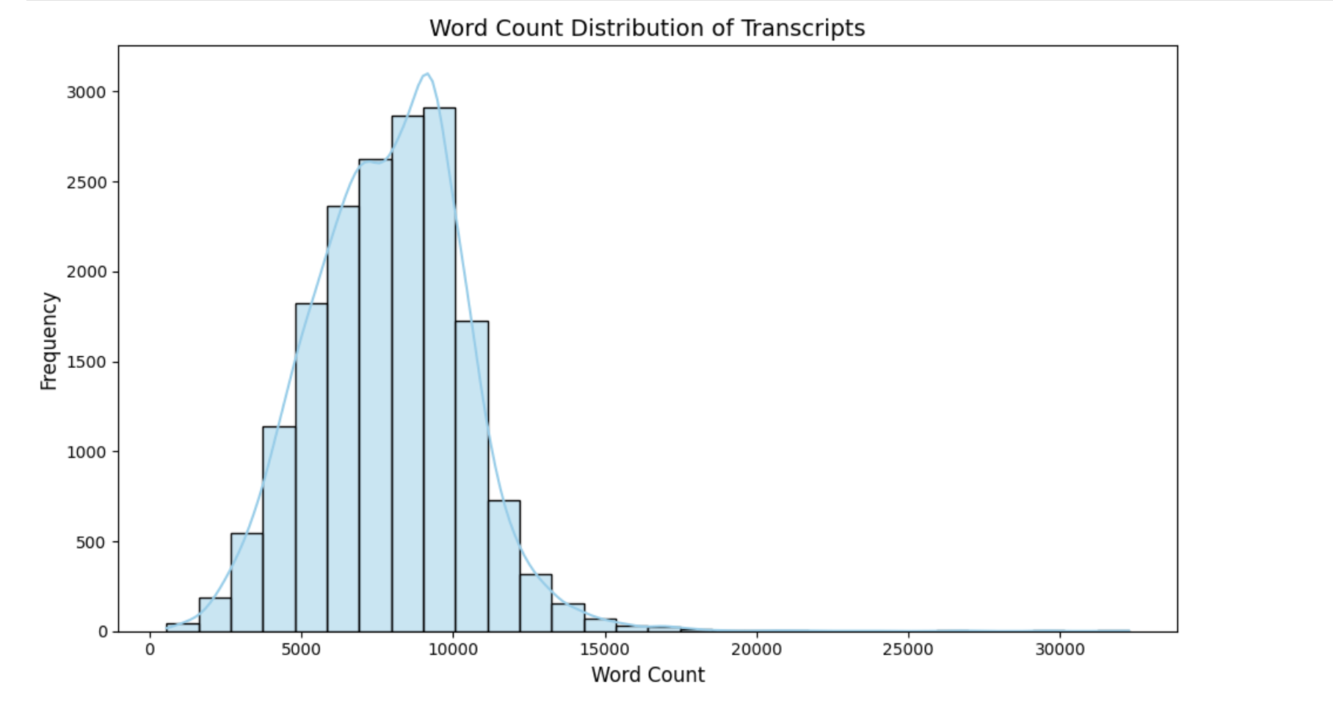

Slide 7
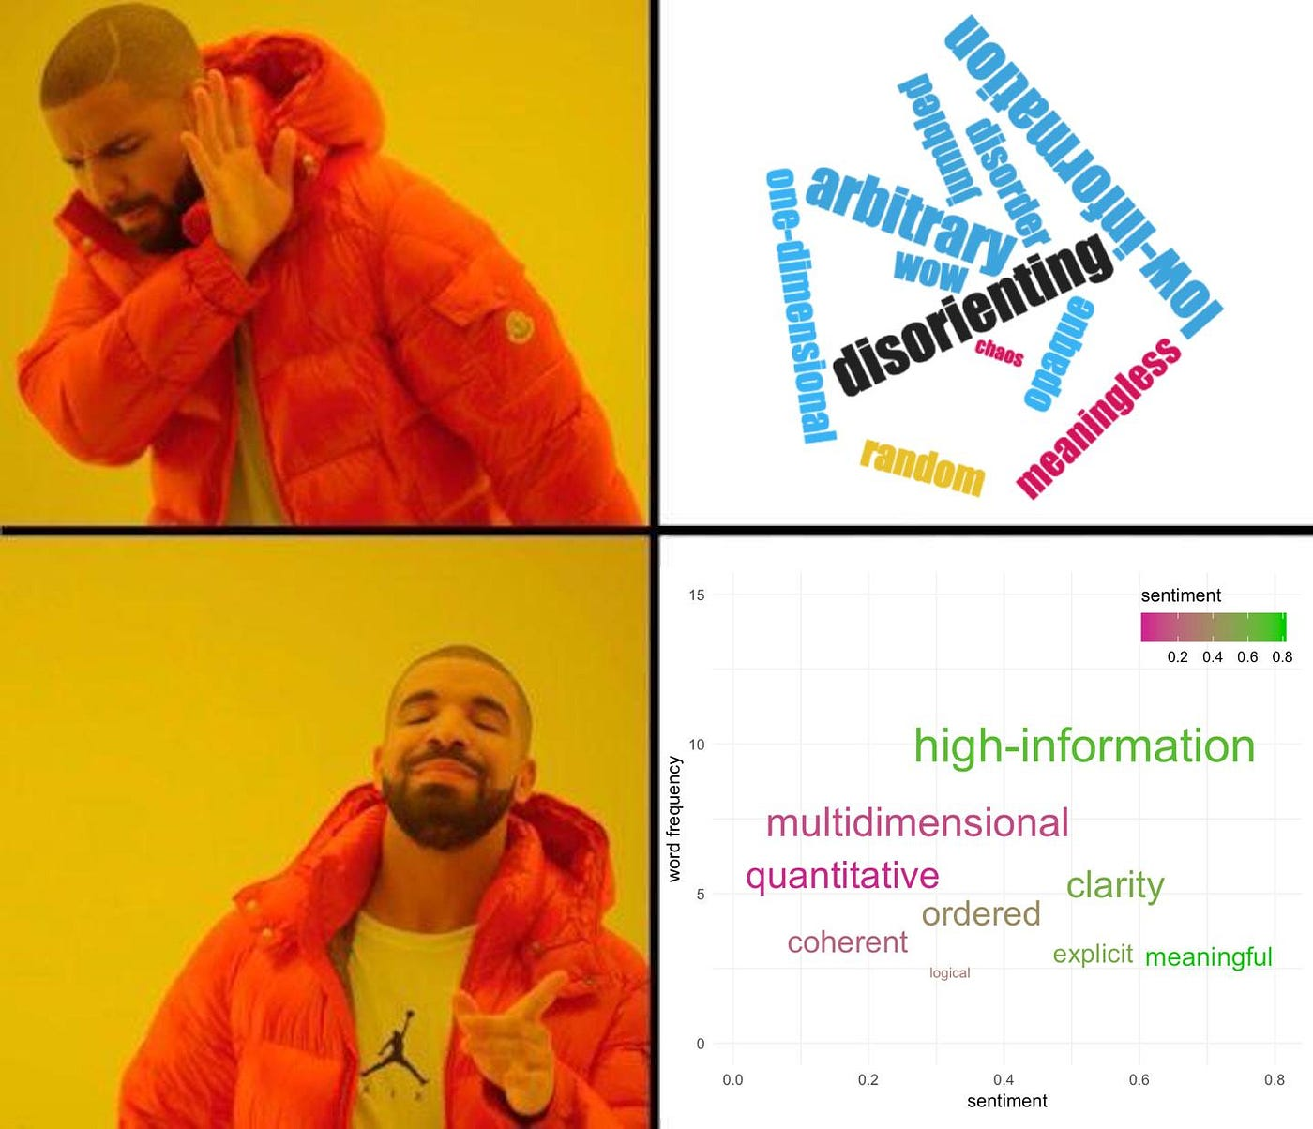

Slide 8
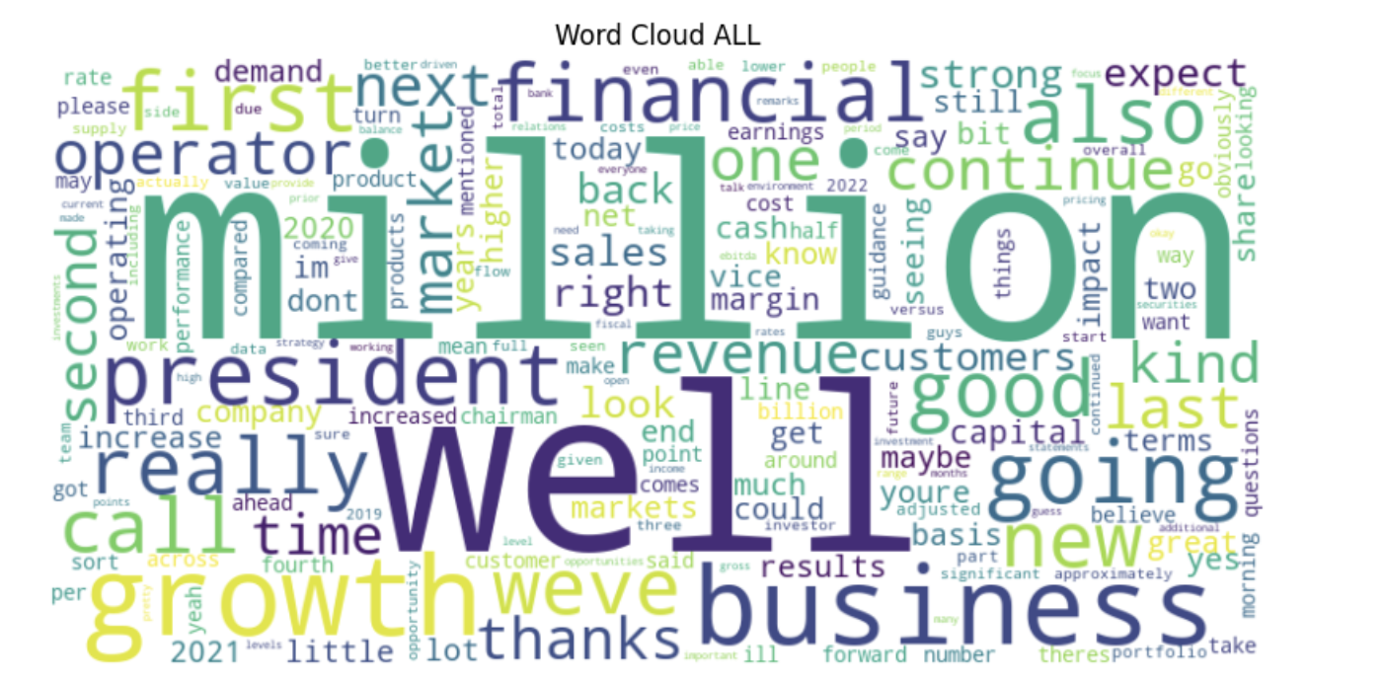
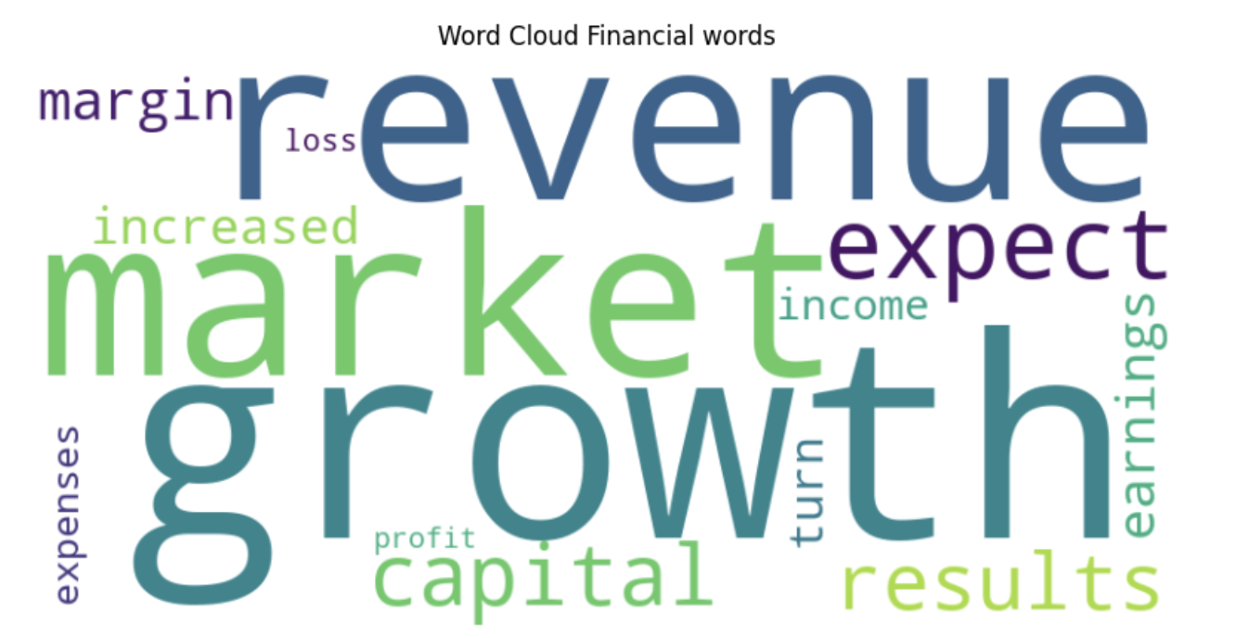

Slide 9
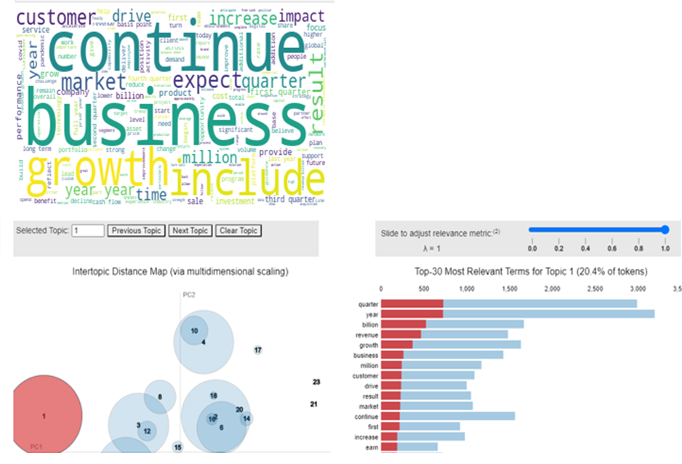
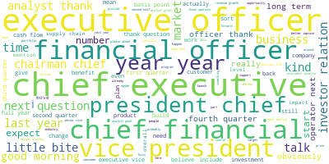
Latent Dirichlet Allocation (LDA)
full transcript (delete role specific word)
cleverly cleaned transcript

Slide 10
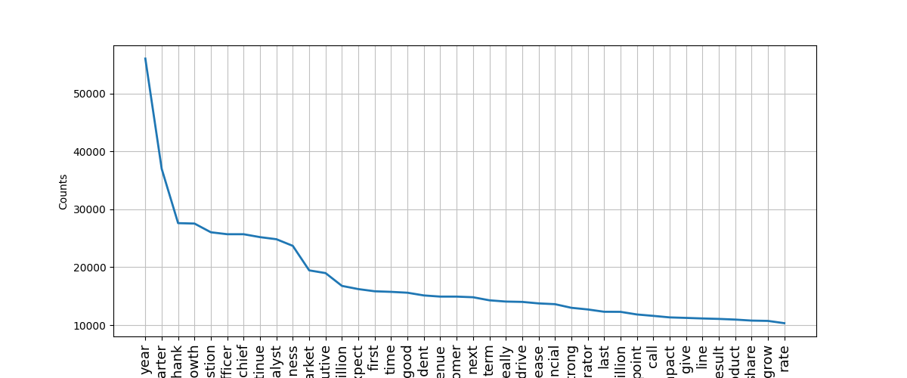
Latent Dirichlet Allocation (LDA)

Slide 11
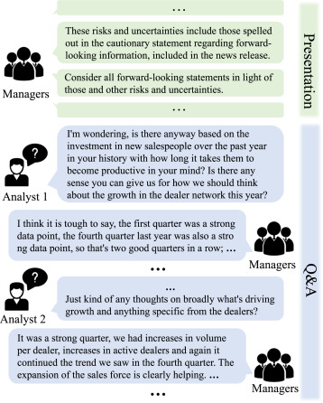
Earnings Call Transcript Data Processing for modelling
S&P100 earnings call transcripts were processed by:
Removing punctuation, and cleaning contractions
Tokenizing, lemmatizing, and removing stop words
Filtering infrequent words
VADER model applied on full transcripts vs cleverly cleaned transcript

Slide 12
VADER Overview
A sentiment analysis model that evaluates text polarity (positive/negative) and intensity using a prebuilt lexicon.
Lexicon-Based: Scores words based on their semantic orientation (positive or negative), aggregating results for document-level sentiment.
Applied to earnings call transcripts, analyzing both full and prepared remarks sections (removing irrelevant sentences, parts and words).
Comparison: Compared VADER's performance with Hu-Liu (HL) and Loughran-McDonald (LM) lexicons for sentiment accuracy in financial contexts.

Slide 13
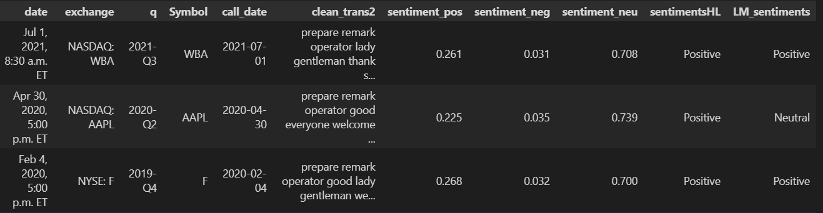
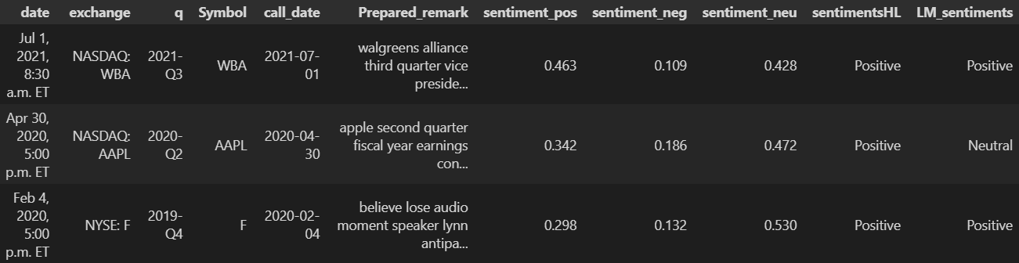
Full Transcript
Cleverly Cleaned Transcript

Slide 14
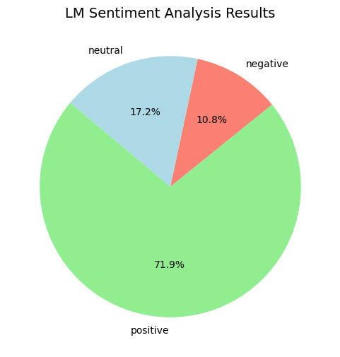
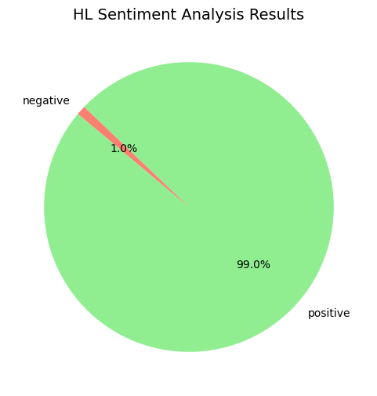
VADER – Sentiment Intensity Analyzer (SIA) Polarity Scoring
Sentimental Test | Using HL Dictionary | Using LM Dictionary
Positive | 771 | 584
Negative | 0 | 55
Neutral | 8 | 140

Slide 15
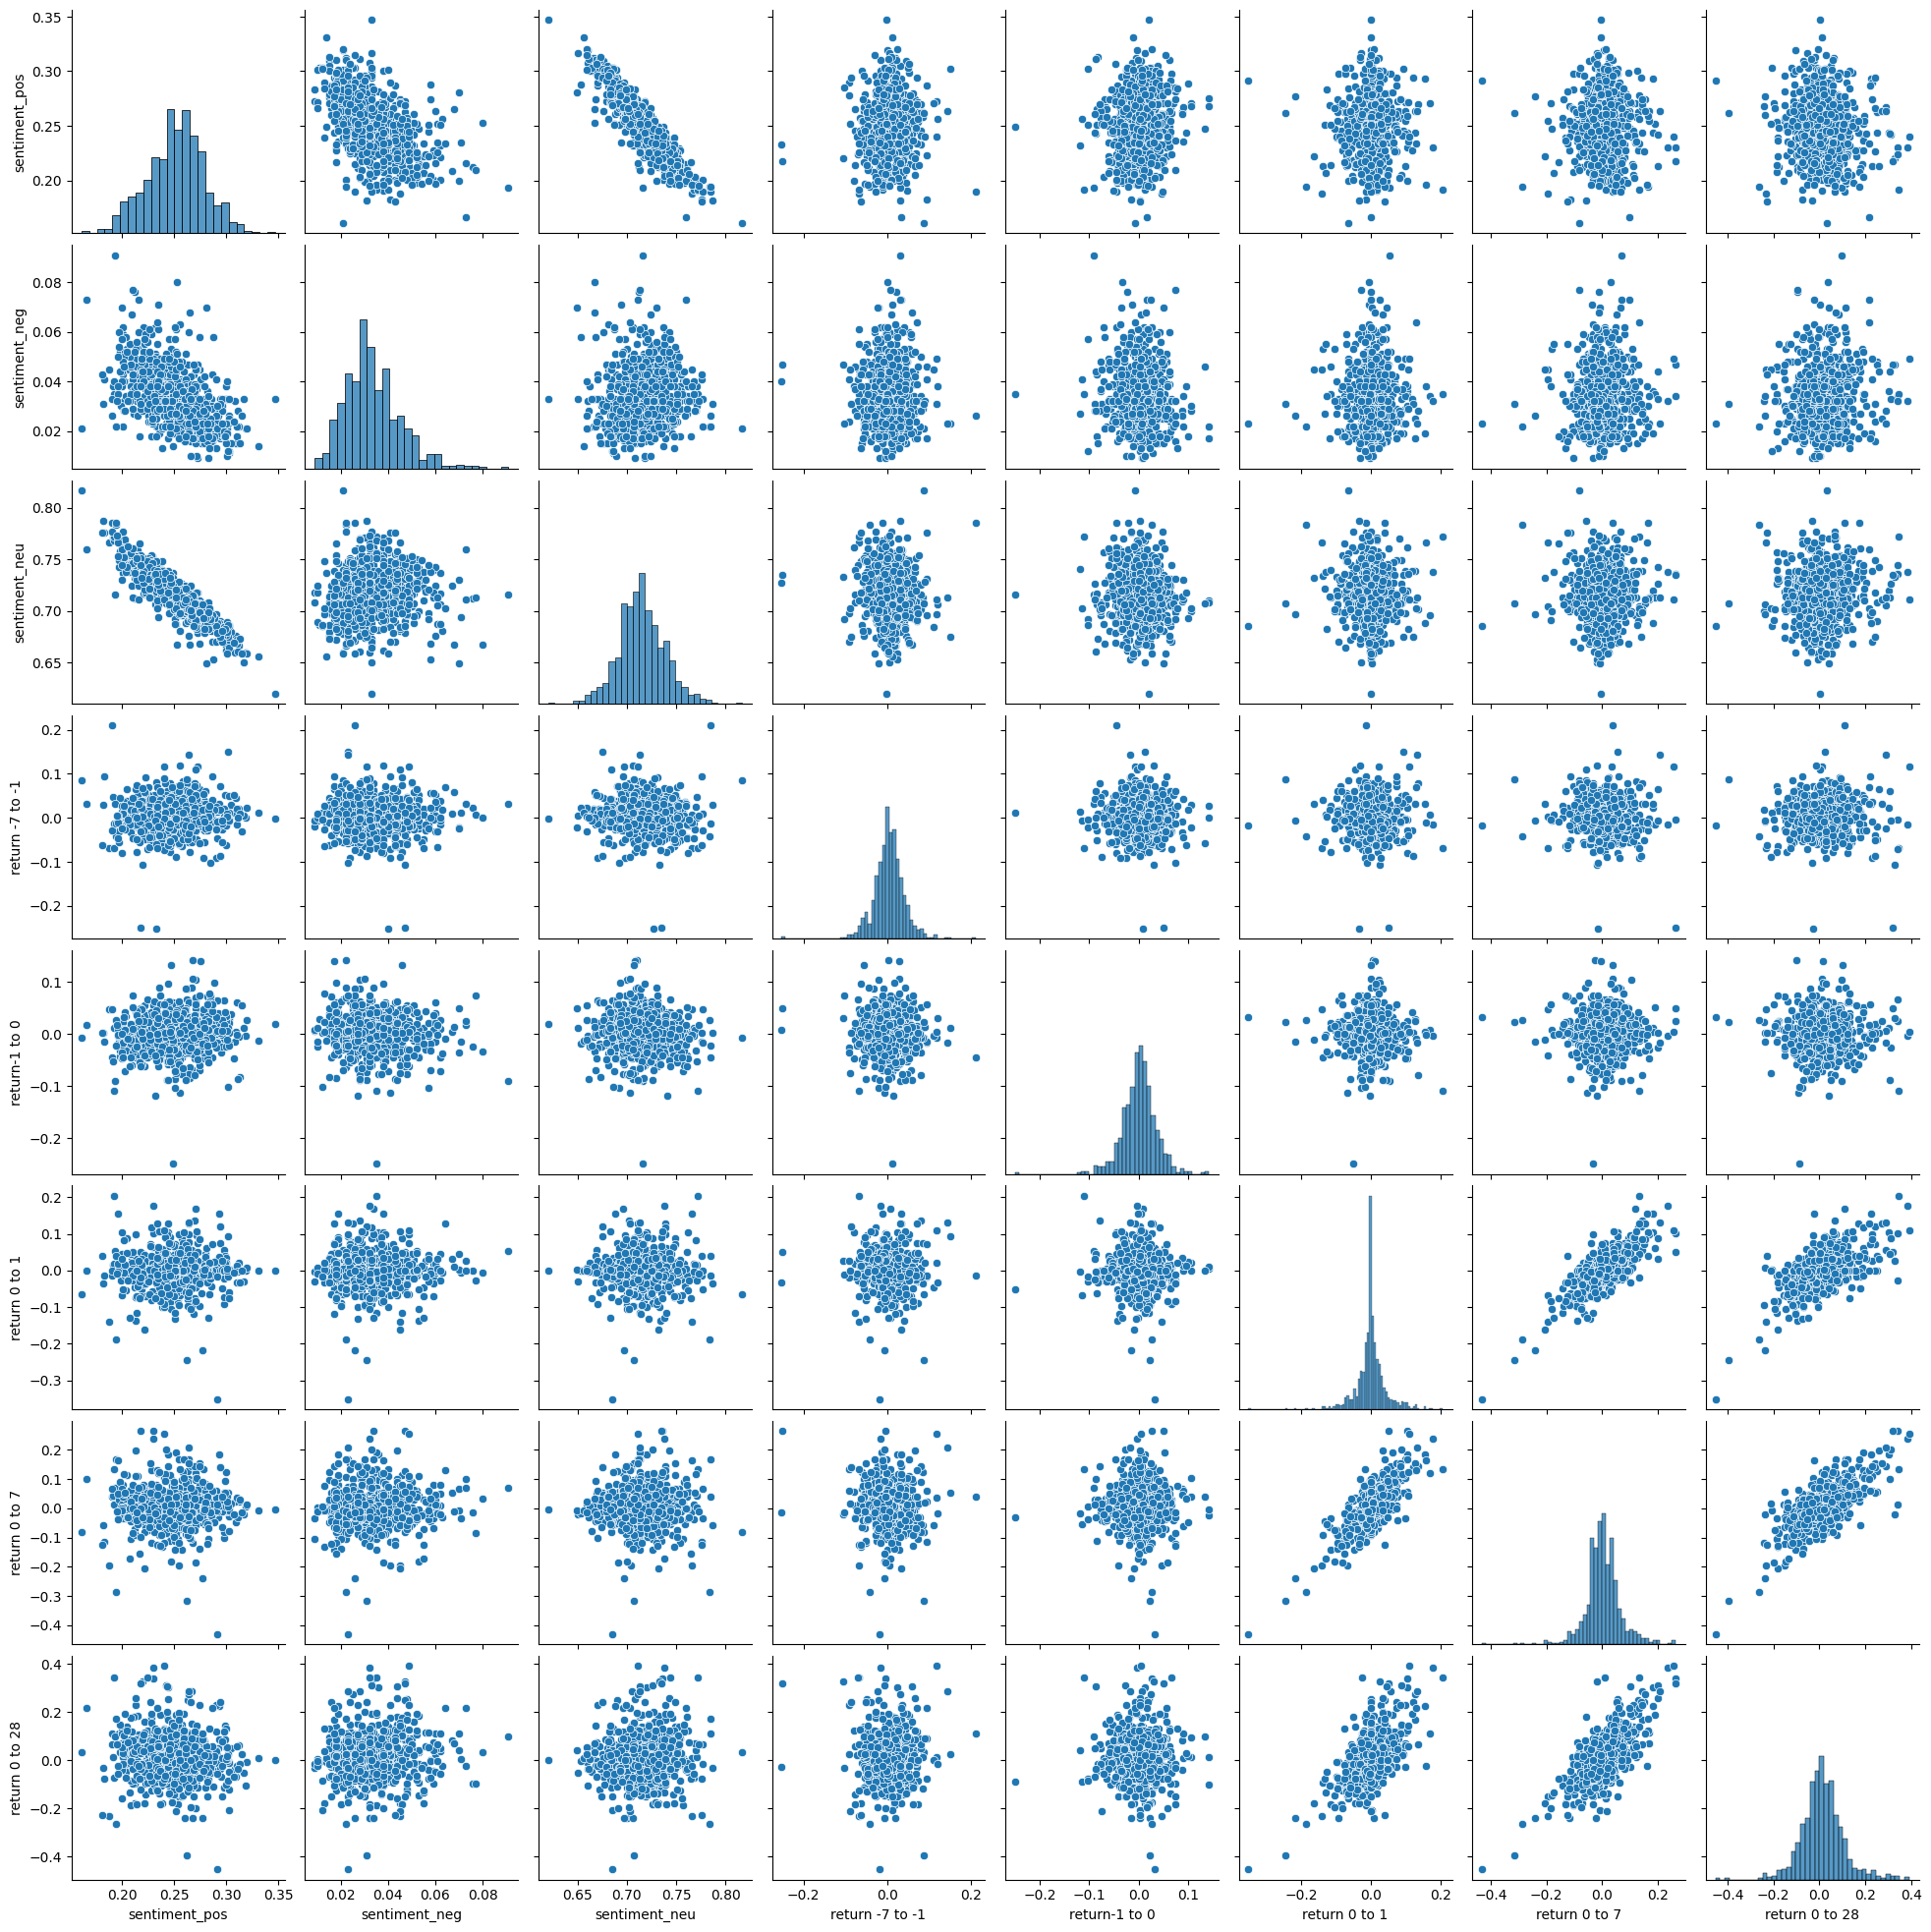
VADER – Correlation Between Sentiment Percentages and Stock Price Returns

Slide 16
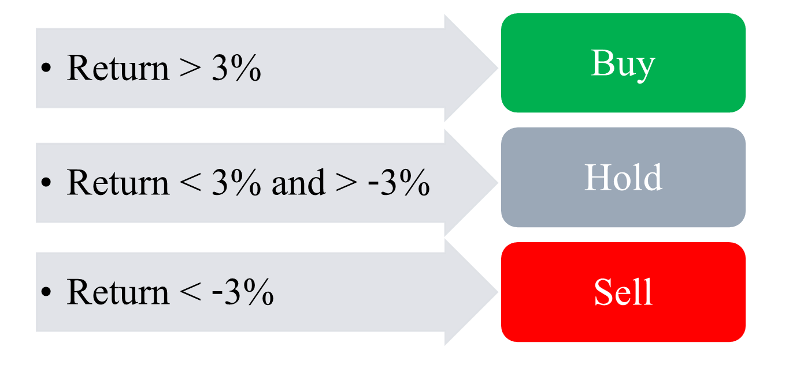
Analysis on Price Changes
Return | 0 to 1 | 0 to 7 | 0 to 28
Positive | 121 | 228 | 305
Negative | 118 | 186 | 213
Neutral | 540 | 365 | 261
Sentimental Test | Using HL Dictionary | Using LM Dictionary
Positive | 771 | 584
Negative | 0 | 55
Neutral | 8 | 140

Slide 17
FinBERT Model
BERT: A powerful language model that understands the context of words in a sentence.
FinBERT is a version of BERT fine-tuned specifically for financial text and sentiment analysis.
FinBERT specializes in financial sentiment analysis, tailored for finance-related text.
Analyzing earnings calls, reports, and financial news to derive sentiment insights.
Hugging Face: A platform offering pre-trained models like FinBERT for easy integration into projects.
Hugging Face Integration: Easy-to-use pre-trained model with APIs for quick deployment.

Slide 18
Data Processing
Extracted participant names and corresponding speech from transcripts
Identified question-askers using the pattern "name – company name – title"
Focused on relevant speakers (company representatives) by excluding question-askers
Applied FinBERT to calculate sentiment scores (negative, neutral, positive) for each participant
Notes:
Applied per speech and applied per sentence

Slide 19
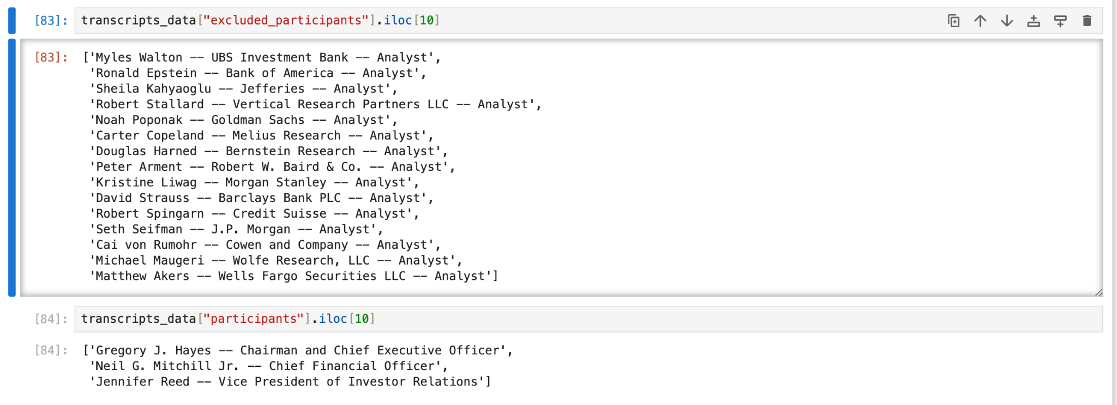
Data Processing

Slide 20
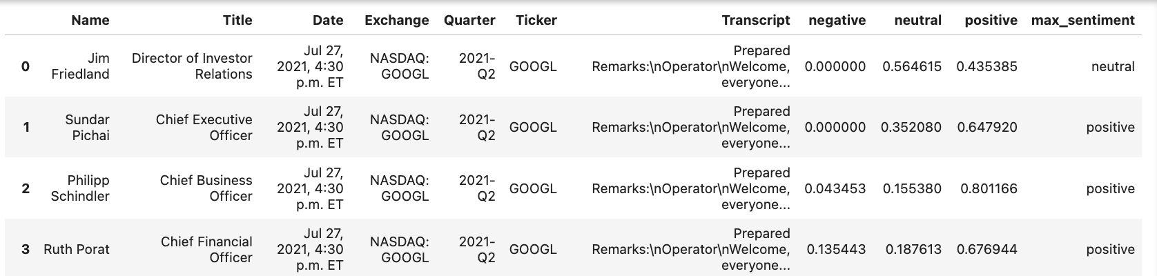
Data Processing

Slide 21
How We Managed Lengthy Participant Speeches
Paragraph-Based Sentiment Analysis:
For longer speeches, we split the text into paragraphs and performed sentiment analysis on each paragraph. This approach ensured that we maintained context while still managing the volume of text.
Sentence-by-Sentence Sentiment Analysis:
We analyzed sentiment on a sentence-by-sentence basis, breaking down each participant's speech to capture sentiment shifts and nuances throughout their contribution.

Slide 22
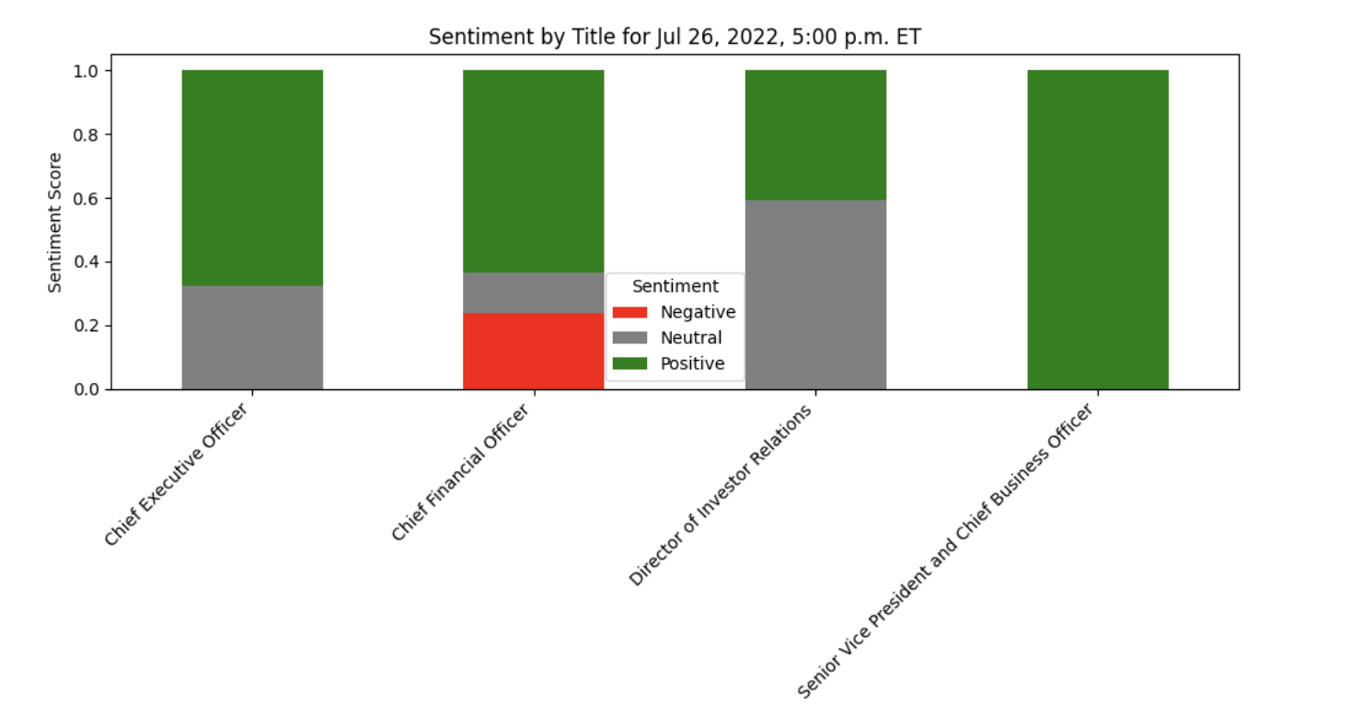
Results GOOGLE by
– CEO Shows Positive Sentiment, CFO Less So
Notes:
In this Figure, we observe an intriguing case during an earnings call for Google.
The sentiment analysis reveals a distinctly negative sentiment in the CFO’s
statements compared to the other participant . This observation indicates we should take a closer look of the transcript to
better understand the context and the specific remarks made by the CFO in the meeting.

Slide 23
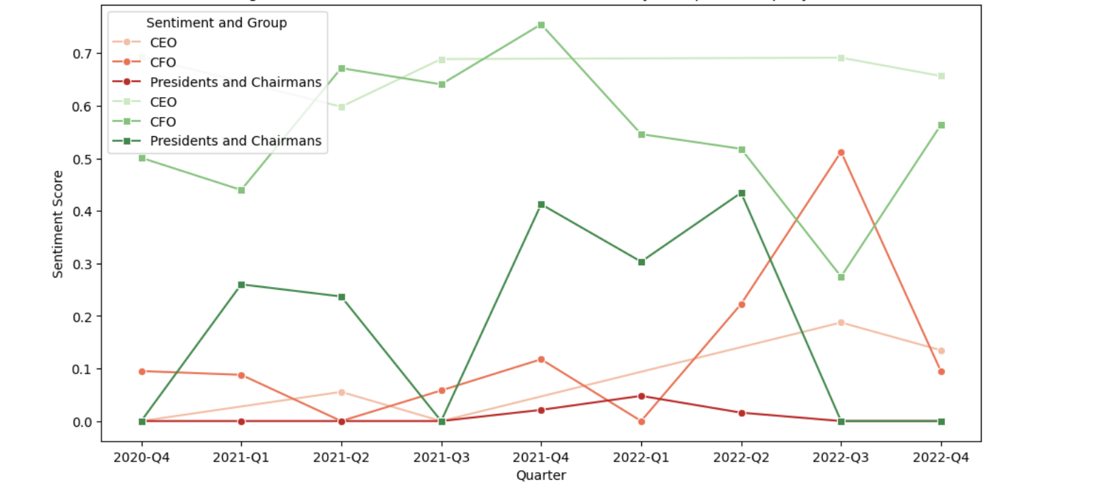
Results DOW
– Negative and Positive Sentiment Across Quarters

Slide 24
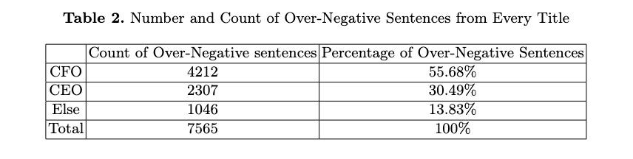
Results: Number of Negative sentence by Participant’s Title
– The Sentimental Analysis by Sentences from FinBERT

Slide 25
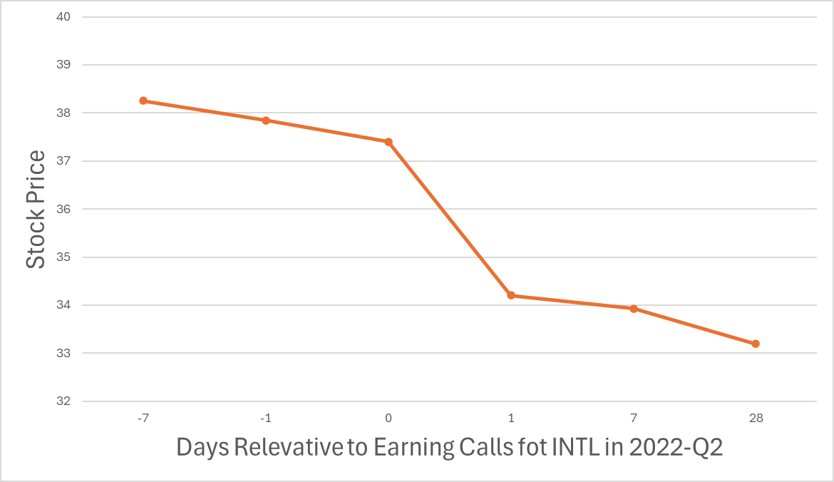
Results Intel 2022-Q2
– The Sentimental Analysis by Sentences from Finbert Model ——

Slide 26
Results Intel 2022-Q2
– The Sentimental Analysis by Sentences from Finbert Model
Three Very Negative Sentences (Probability Score=1) from the speeches of the CFO of INTEL in the 2022-Q2 earnings call:
“revenue was $15.3 billion, 15% below our original q2 guidance as our ccg and dcai businesses both underperformed our expectations.”
“dcai revenue was $4.6 billion, below expectations and down 16% year over year on oem inventory reductions, mix-related asp decline and competitive pressures.”
“and maybe i'll just add, in terms of profitability, it was disappointing where operating margins landed for the dcai business for sure.”

Slide 27
Conclusion and Q&A
Used VADER and FinBERT for sentiment analysis of earnings call transcripts.
At present no findings of strong correlation between sentiment and stock prices across all companies.
CEOs tended to express more positive sentiment than other speakers.
Sentiment patterns showed some links to stock price movements for certain companies
Future work:
Investigate further sentiment by different speaker roles
Explore sector-specific sentiment patterns
Test additional financial models for better accuracy
Analyze the correlation between some very negative sentences and the stock movement before and after the earnings call

